Slide 1


Rodrigo Arriaza Rojas
April 9th, 2025

Slide 2

Outline
Executive Summary
Introduction
Methodology
Results
Conclusion
Appendix

Slide 3
Executive Summary
Summary of methodologies
-Data was gathered from SpaceX API and Wikipedia JSON using web scraping tools.
-Performed data wrangling to clean, transform, and engineer relevant features such as landing success and distance to coast.
-Conducted exploratory data analysis (EDA) using SQL queries and data visualization.
-Built interactive dashboards with Folium for geospatial analysis and Dash for visual analytics
-Trained and tested several classification models to predict landing success.
Summary of all results
-Most of the models reached 83.35 accuracy
-Payload mass, booster version, and launche site were among the top predictors
-Visual analysis suggested distance to coast and infrastructure ,ight impact landing results

Slide 4
Introduction
Project background and context
SpaceX aims to reduce the cost of space travel by developing reusable rocket technology. One of the challenges is ensuring whether the first stage of the Falcon 9 lands successfully after launch. This project focuses on analyzing historical launch data to understand the factors that influence landing success and develop predictive models that can anticipate landing success or failure. By improving prediction accuracy, the company can optimize mission planning, reduce risk, and save costs.
Problems you want to find answers
This project aims to identify the features and hyperparameters that best predict success or failure in a Falcon 9 landing:
1. Can we accurately predict the outcome of a Falcon 9 landing based on historical data?
2. What machine learning models perform best for this type of classification task?
3. How can data visualization support the understanding of launch performance and success rate?

Slide 5

Section 1

Slide 6
Methodology
Executive Summary
Data collection methodology: Collected data from SpaceX (JSON API) and Wikipedia using web scraping.
Data wranglingHandled missing values (NaN, nulls), removed irrelevant columns, and created new features for analysis and modeling.
Exploratory Data Analysis (EDA)Used SQL to query the dataset and Seaborn to visualize patterns and feature relationships.
Interactive Visual Analytics: Used Folium to map launch sites and applied clustering to classify launch outcomes by location.
Predictive Analysis: Built, tuned, and evaluated classification models to predict Falcon 9 landing success.

Slide 7
Data Collection
-We used BeautifulSoup and requests libraries in Python to scrape historical data from Wikipedia page titled “List of Falcon 9 and Falcon heavy launches”. The tables were parse and converted into pandas DataFrames.
-We accessed SpaceX REST API endpoints using requests.get() to retrieve launch data in a JSON format. The JSON response was normalized and converted into pandas DataFrames.
After that, the cleaned data was saved into a .csv file to be used in the next stages.
Data collection Process:
Web scarping (Rest API and Beautifulsoup) -> JSON file -> JSON normalization -> Creation of pandas DF -> saved as .csv file

Slide 8
Data Collection – SpaceX API
Space X REST API was used to collect detailed launch data in JSON format. Using requests library, we accessed endpoints such as /launches. The responses were parsed and normalized using json_normalize( ) from pandas, and then stored in Dataframes for the next steps.
View API data collection NB on GitHub:
Click here
API call
JSON response
pd.json_normalize
Pandas DataFrame
Export to CSV

Slide 9
Web scraping libraries (BeautifulSoup, requests) were used to scrape Falcon 9 launch data from Wikipedia. Columns and rows were extracted and stored in a pandas DataFrame. The data was then saved as a .csv file for further analysis.
Data Collection - Scraping
Web scraping libraries (BeautifulSoup, requests) were used to scrape Falcon 9 launch data from Wikipedia. Columns and rows were extracted and stored in a pandas DataFrame. The data was then saved as a .csv file for further analysis.
View data collection webscraping NB on GitHub:
Click here
HTTP get
BeatifulSoup
Parse table
Create DataFrame
(Pandas)
Save as .csv

Slide 10
Data Wrangling
After .csv file was loaded, we scanned the dataset to for missing values (NaN) and duplicates. Once cleaned, we removed irrelevant rows and created new features (such as “landing_outcomes”) to support further analysis.
View the Data wrangling notebook on Github:
Click Here
Load .csv
Check NaN/duplicates
Clean
Feature engineering
DF to .csv

Slide 11
EDA with Data Visualization
A catplot was used to verify if PayloadMass correlates with FlightNumber, and whether FlightNumer is related to LaunchSite.
A scatterplot was used to find a correlation between PayloadMass and LaunchSite, and to explore relationships between Flight Number vs Orbit Type, and Payload vs Orbit type.
A barplot was used to visualize the relationship between success rate according to the orbit type.
Finally, a lineplot was used to visualize the launch success rate in a yearly trend.
View EDA data visualization Notebook on GitHub:
Click Here

Slide 12
EDA with SQL
SQL queries used:
Queried distinct values of LaunchSite to identify launch site distribution
Used GROUP BY and COUNT(*) to calculate success rate by launch site.
Used aggregated functions like AVG() and MAX() to analyze average and maximum payload mass
Filtered by “Booster_Version” and “Payload_Mass_KG_” between 4000 and 6000 for targeted analysis.
Extracted year from launch date to analyze yearly trends in launch success.
View SQL notebook on GitHub:
Click Here

Slide 13
Build an Interactive Map with Folium
Folium
We used circles to mark the launch sites in the United States map. PolyLines were added to represent areas of interests (highways, coastline, railways, etc) to measure the distance between them and the launch sites.
We also used colored-markers and marker cluster to represent different outcomes (success/failure) and to explore spatial patterns in launch success.
These objects were added to engance spatial understanding of the data. Circles help localize the launch sites, polylines show proximity to geographic elemens, and colored markers/clusters help identify possible correlations between location and launch outcomes.
View Folium notebook on GitHub:
Folium NB
Download HTML map

Slide 14
Build a Dashboard with Plotly Dash
The dashboard includes a pie chart that shows launch site and success/failure distribution, as well as a scatter plot that shows the relationship between payload mass and success rate.
Interactive components such as dropdown menu to select launch site, and a range slider (to filter payload mass) were added to the dashboard.
These visualizations were used to identify patterns in success rates across launch sites and payload ranges. The control allows the stakeholder to explore different launch sites and payloads.
View Dash app on GitHub:
Click here

Slide 15
Predictive Analysis (Classification)
We split the data set into training and testing (80/20)
Multiple classifiers were trained, including Logistic Regression, SVM, Decision Trees, and K-Nearest Neighbors (KNN)
Hyperparameters were tuned using GridSearch CV
The best model was SVM with a sigmoid kernel with: Accuracy on training: 84.8% and accuracy on test set: 83.3%
Accuracy was used as the evaluation metric throughout the experiment.
View the predictive analysis notebook on GitHub:
Click here
Processed data
Train/test split
Train classifiers
Hyperparameter
tuning
Evaluate performance

Slide 16
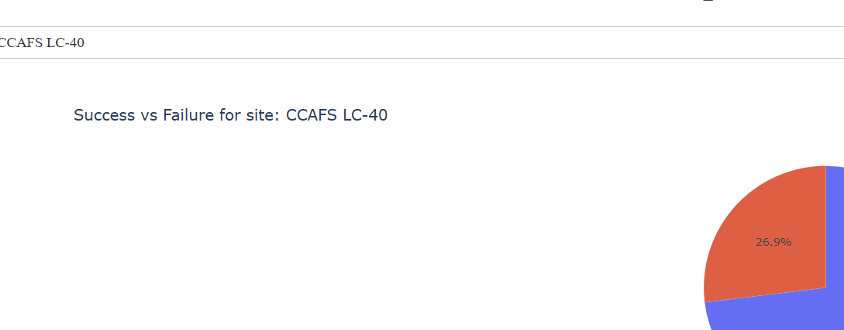
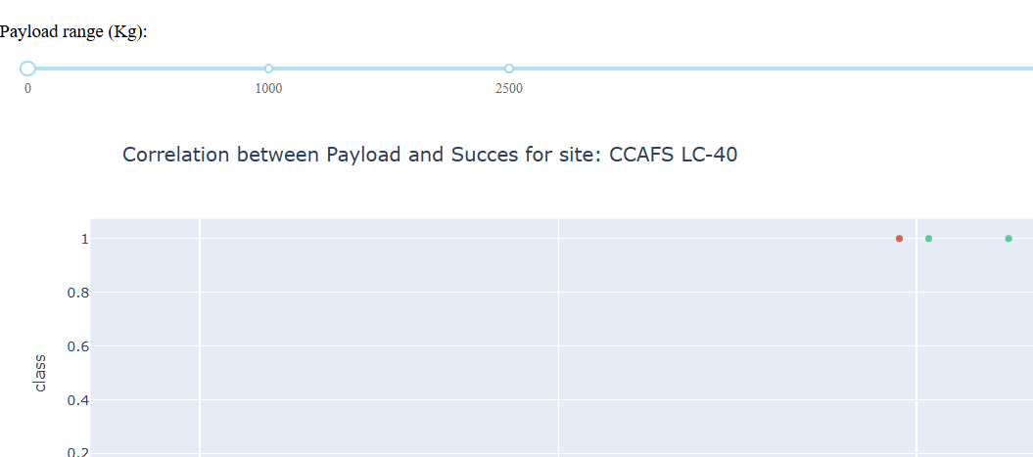
Results
During EDA phase, we analyzed the correlation between variables such as Payload Mass, Launch Site, and Orbit Type with the type of landing outcome.
On the right side you can see the interactive dashboard demo with a dropdown menu for launch sites and a slider to filter Payload Mass.
Four classification models were trained and evaluated using cross-validation and grid search.
Confusion matrices showed that most models had low false positives, with Logistic Regression achieving perfect recall for successful landings in our test set.

Slide 17

Section 2

Slide 18
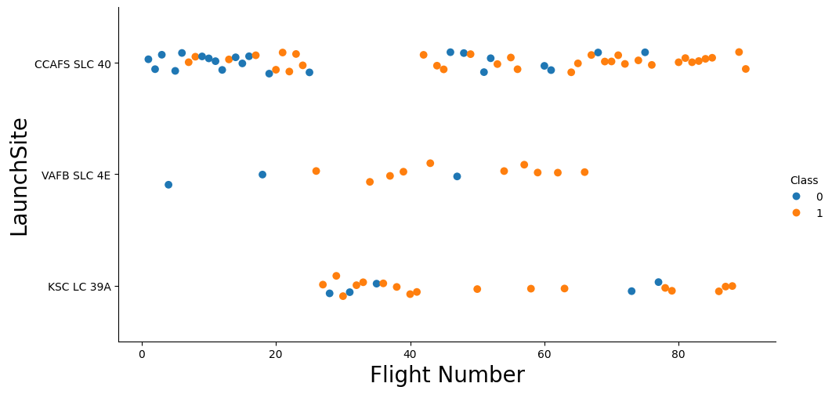
Flight Number vs. Launch Site
The scatter plot show a relationship between flight number and launch site. We can observe that initial launches had more failures, as flight number increases, launch success becomes more consistent. Observe specific sites like CCAFS LC-40.

Slide 19
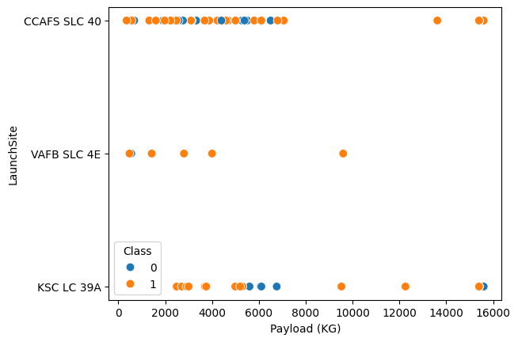
Payload vs. Launch Site
Overall, we can observe that launches with máximum payload have a high success rate. However, we must consider the large difference in launch activity across sites like CCAFS, VAFB and KSC

Slide 20
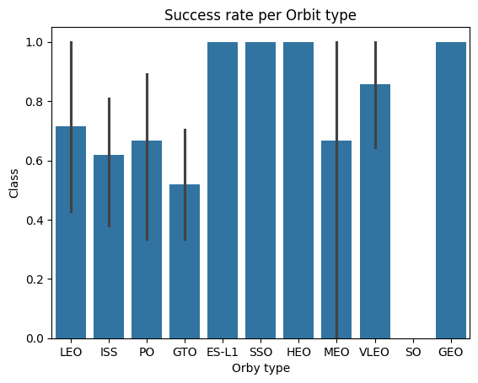
Success Rate vs. Orbit Type
Accordingg to this plot, ES-L1, SSO, HEO, and GEO
Exhibit the Highest success rates.

Slide 21
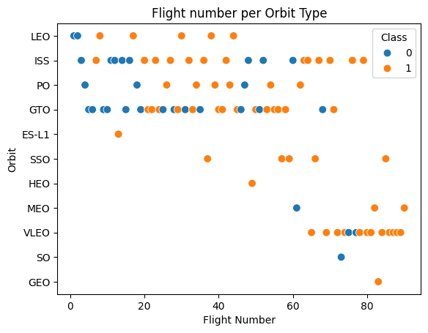
Flight Number vs. Orbit Type
We can observe that in the LEO orbit, the success rate is positively related to the number of flights. On the other hand, for GTO, there appears to be no clear relationship between the number of flights and the success rate.

Slide 22
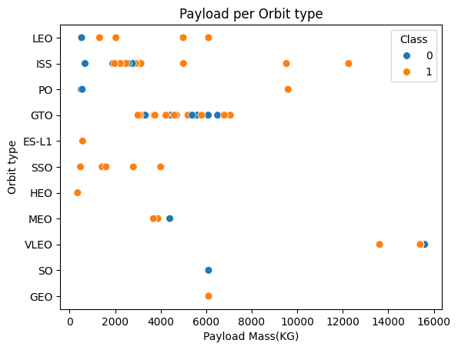
Payload vs. Orbit Type
Polar, LEO and ISS have a better lading rate with
Heavier payloads.
In contrast, for GTO, it is not posible to determine a clear relationship between payload weight and landing success rate.

Slide 23
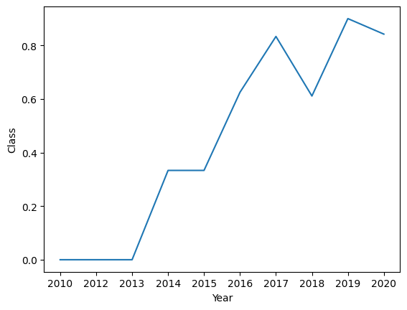
Launch Success Yearly Trend
We can observe that launches were less consistent before 2013. Since then, the success rate has been steadily improving
2019 shows a minor decline, breaking the upward trend in success rate.

Slide 24
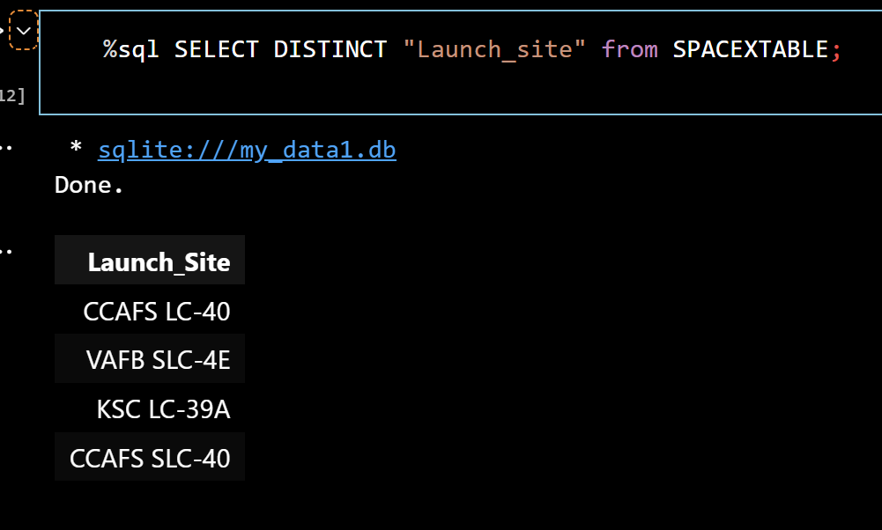
All Launch Site Names
There are four unique launch sites used by SpaceX
In the dadtaset. Such names were obtained using
the DISTINCT keyword in a SQL query

Slide 25
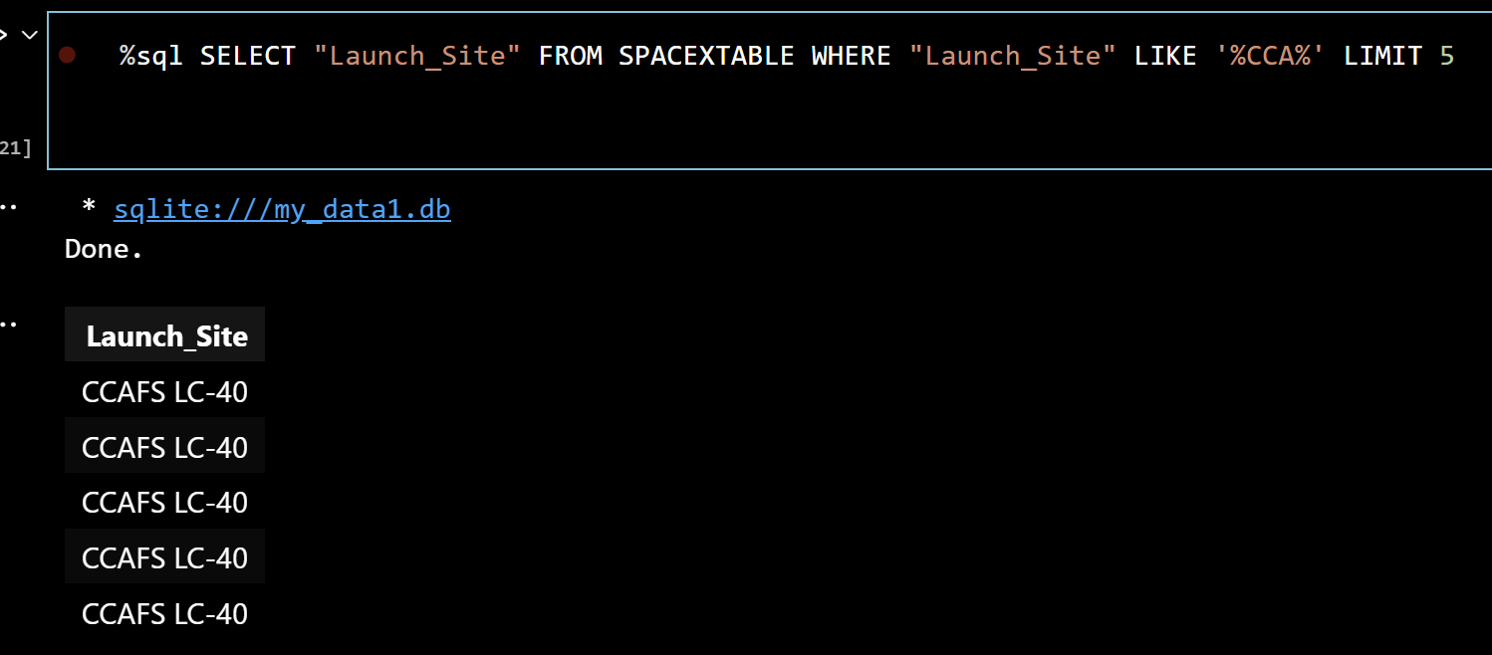
Launch Site Names Begin with 'CCA'
Query was filtered using the keyword WHERE and the wildcard %CCA%
To obtain launch sites starting with “CCA”. LIMIT 5
Was used to show the first 5 entries

Slide 26
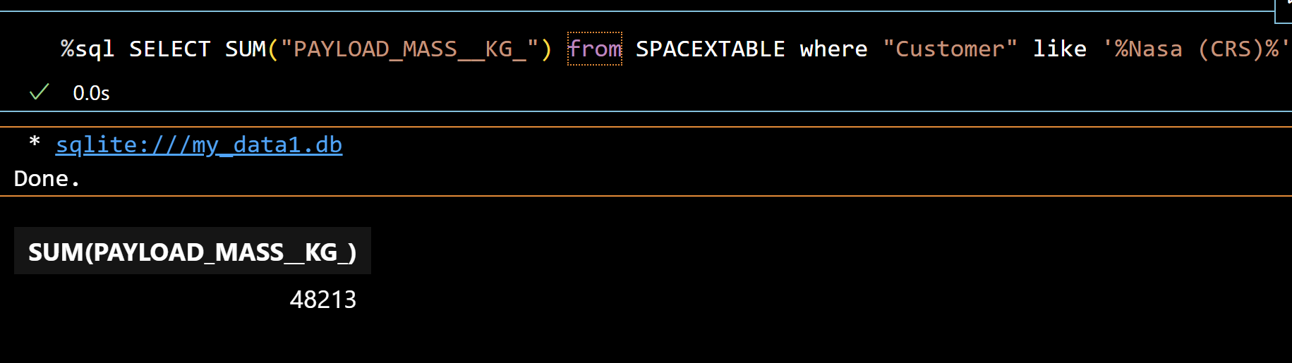
Total Payload Mass
The SUM aggregation function was used on the “PAYLOAD_MASS_KG_” column, and a WHERE clause was applied to filter only the launches where the customer was NASA CRS.

Slide 27
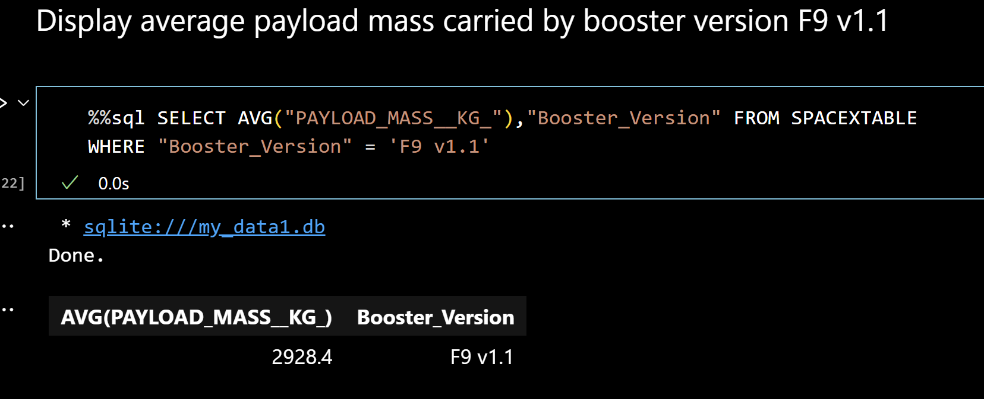
Average Payload Mass by F9 v1.1
The query filters the dataset to include only records with Booster Version F9 v1.1, and then calculates the average payload mass for those launches using the AVG() aggregation function.

Slide 28
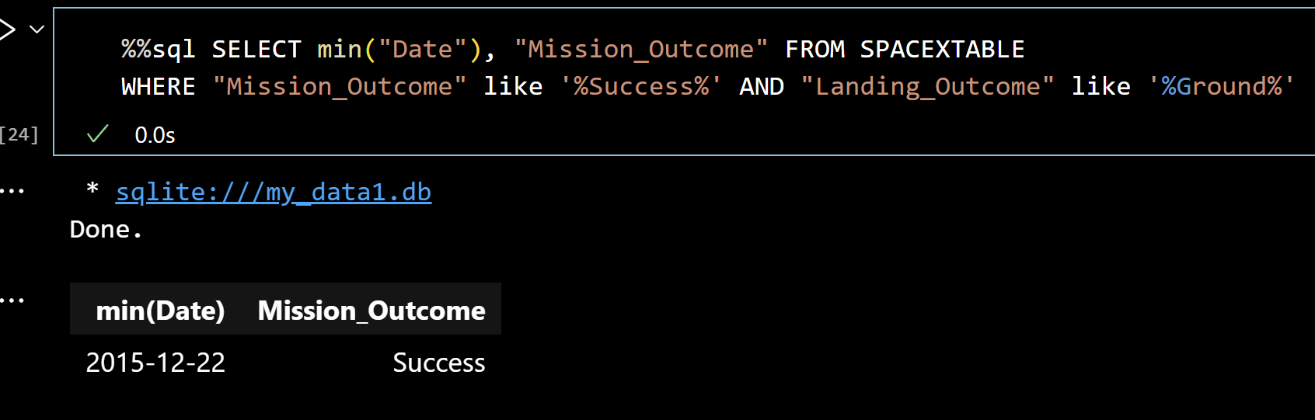
First Successful Ground Landing Date
To find the first successful ground landing, we used the MIN() aggregate function on the Date column. Then, we filtered the results using the WHERE clause combined with wildcards: %Success% for Mission_Outcome and %Ground% for Landing_Outcome.

Slide 29
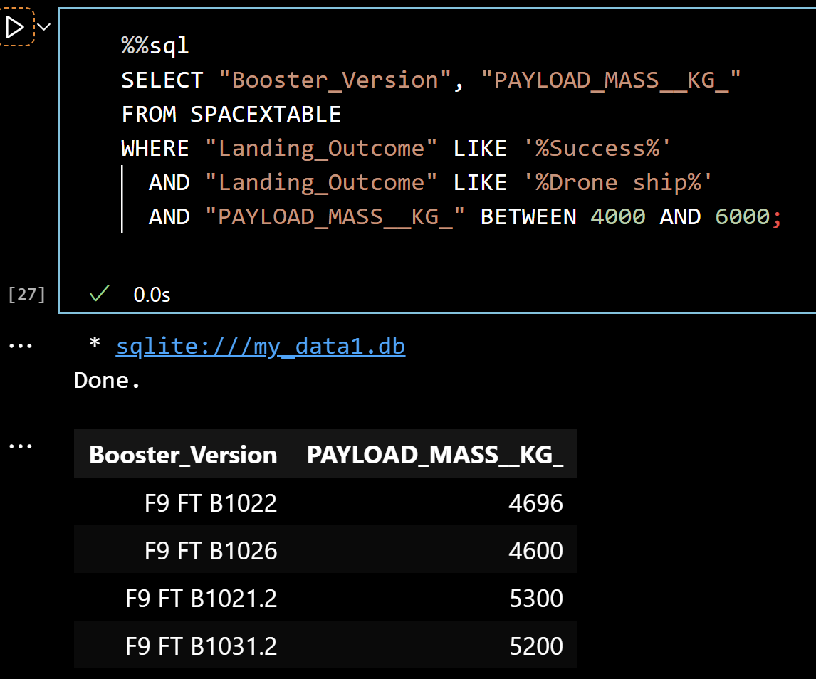
Successful Drone Ship Landing with Payload between 4000 and 6000
This query was designed to retrieve all successful landings on drone ships where the payload mass ranged between 4000 and 6000 kg.We used the LIKE '%Success%' and LIKE '%Drone ship%' filters to narrow down the landing outcomes, and applied the BETWEEN clause to limit the payload mass range.

Slide 30
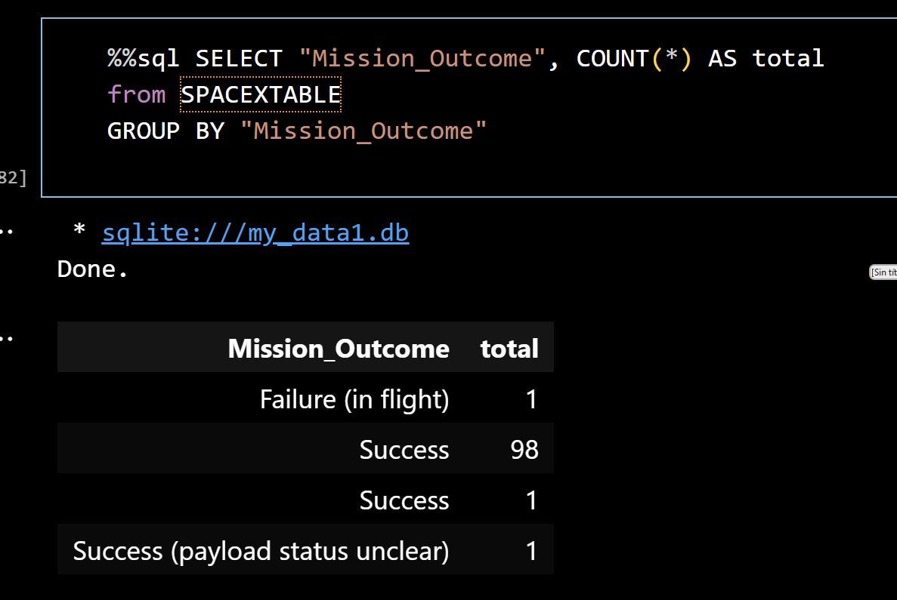
Total Number of Successful and Failure Mission Outcomes
We selected Mission_Outcome and used the COUNT(*) aggregation function to calculate the total number of missions for each outcome. The results were grouped using GROUP BY Mission_Outcome.

Slide 31
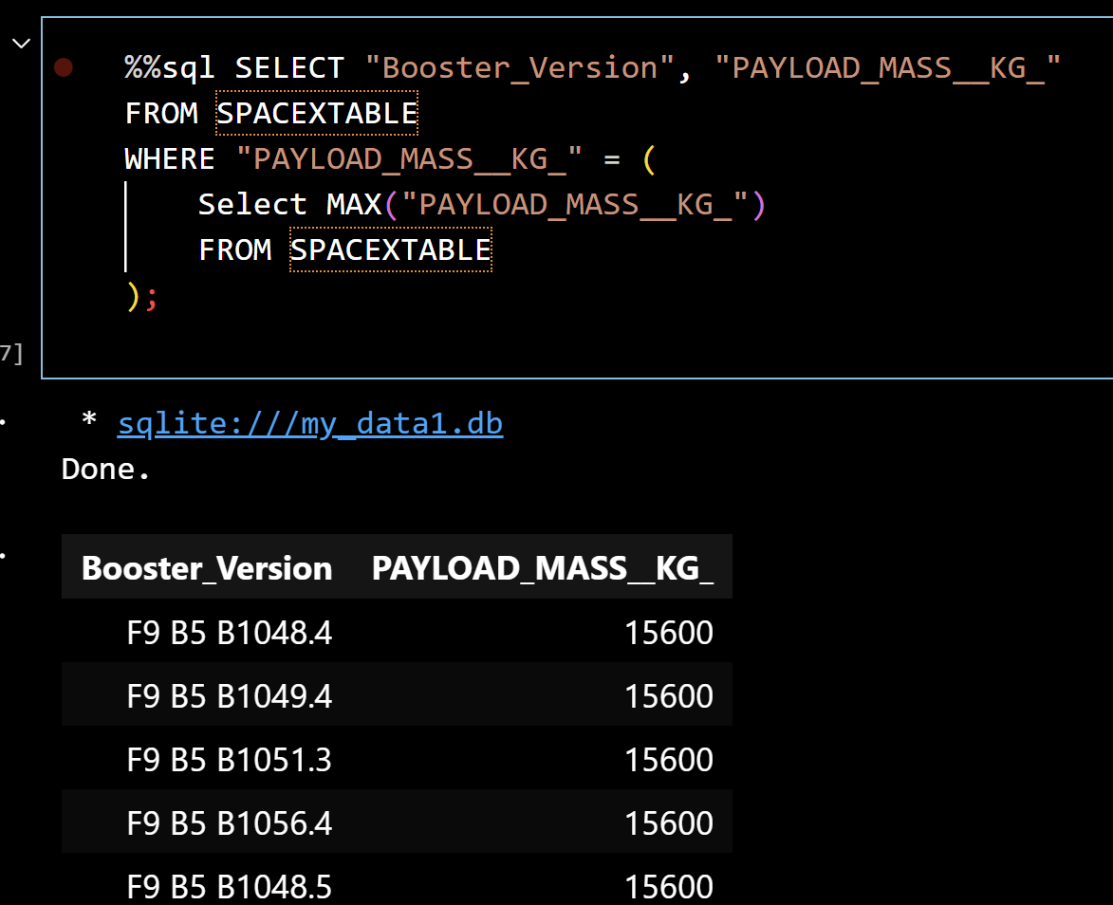
Boosters Carried Maximum Payload
We selected Booster_Version and PAYLOAD_MASS__KG_, then used a subquery to filter the results and retrieve only the rows with the maximum payload mass.

Slide 32
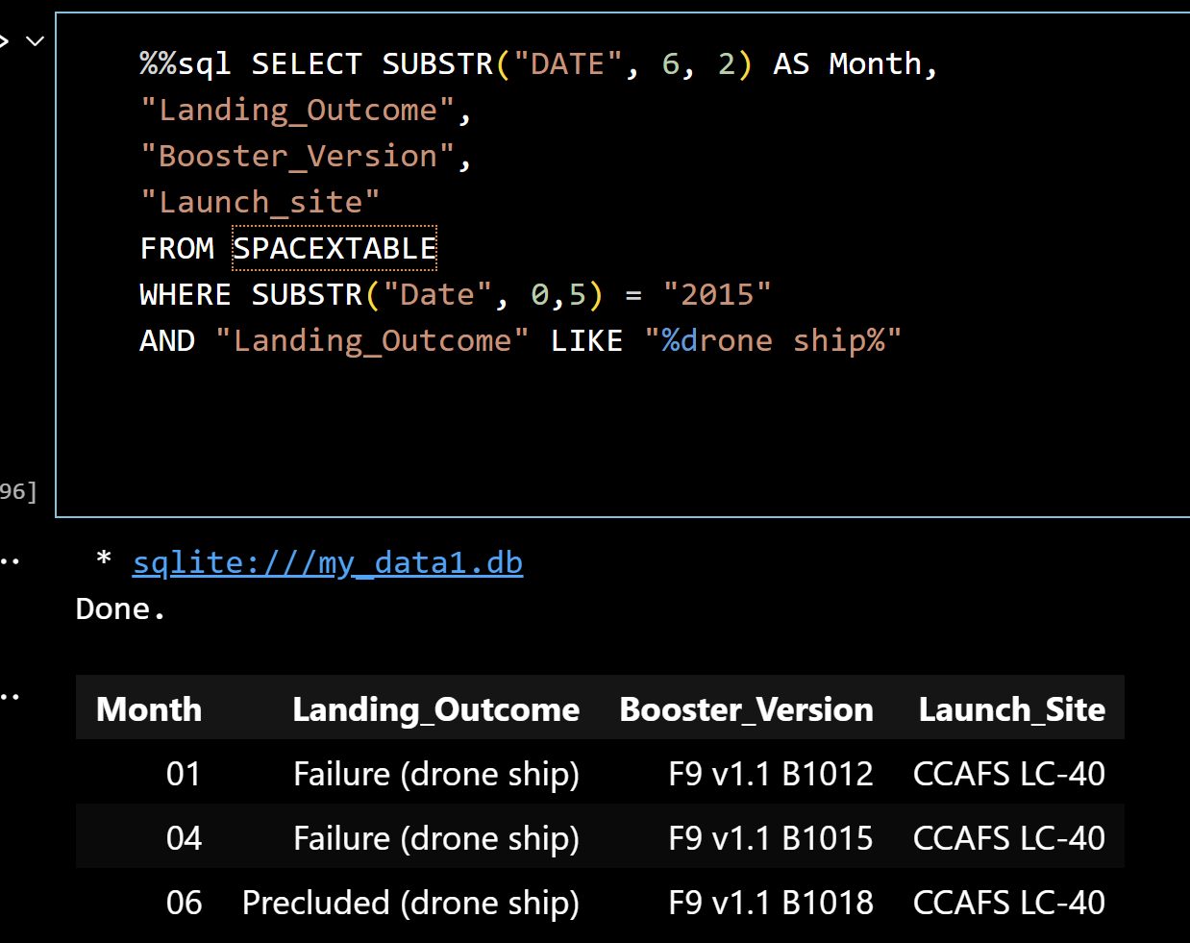
2015 Launch Records
We selected all records from 2015 where the landing outcome involved a drone ship. The SUBSTR function was used to extract the month from the date for better readability.

Slide 33
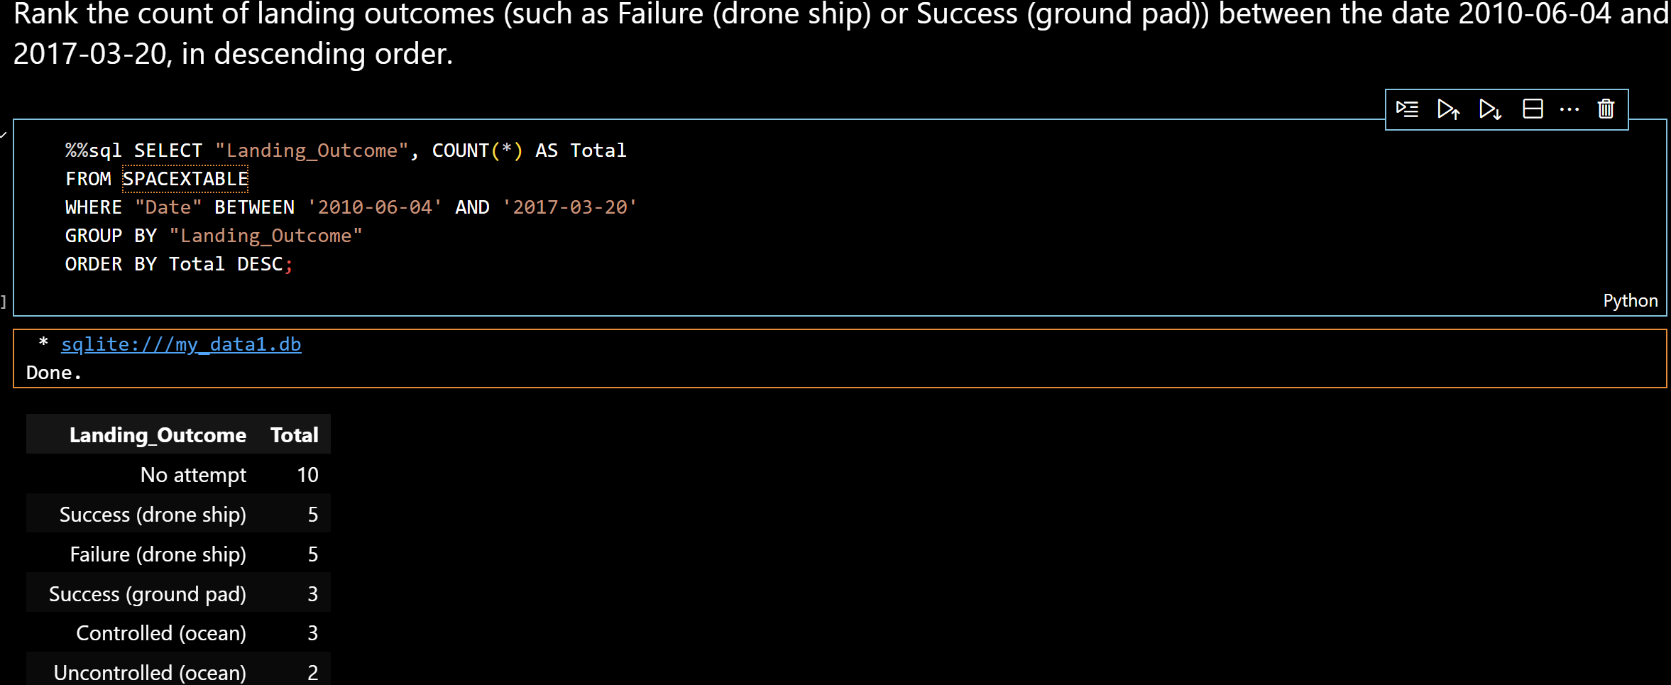
Rank Landing Outcomes Between 2010-06-04 and 2017-03-20
We used a COUNT() aggregation with GROUP BY on Landing_Outcome, filtered by date range, and sorted the results in descending order to identify the most frequent outcomes between 2010 and 2017.

Slide 34

Section 3

Slide 35
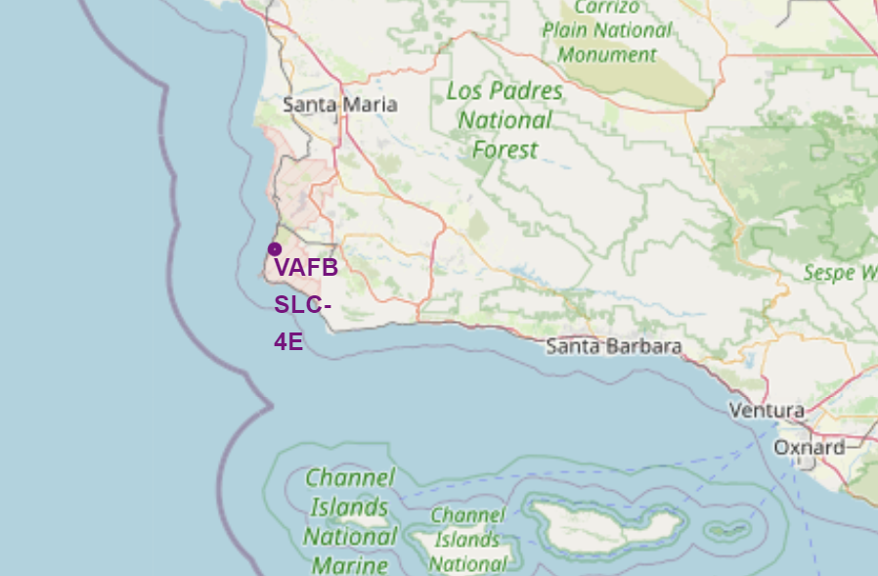
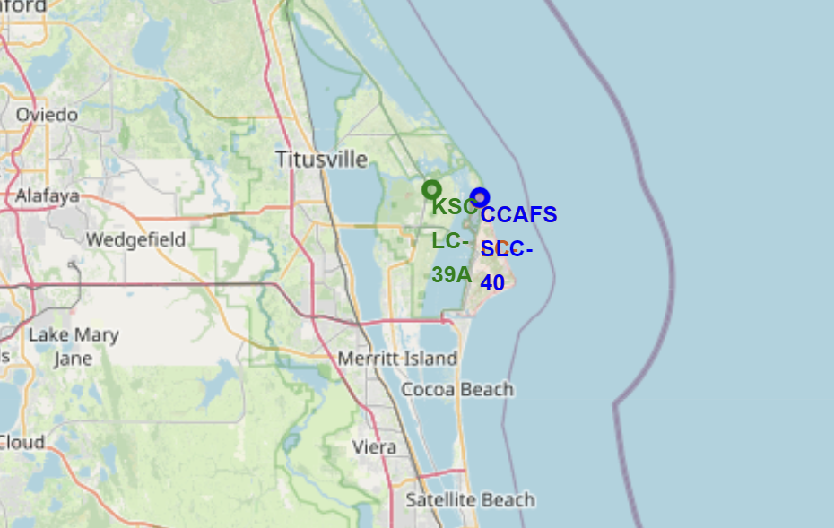
Geospatial Distribution of SpaceX Launch Sites with Folium
Folium map shows that SpaceX launchs sites in California (VAFB) and Florida (KSC and CCAFS).
Markers include launch pad codes (LC_39ª, SLC-40, SLC-4E)
Locations are chosen based on access to ocean and optimal launch conditions

Slide 36
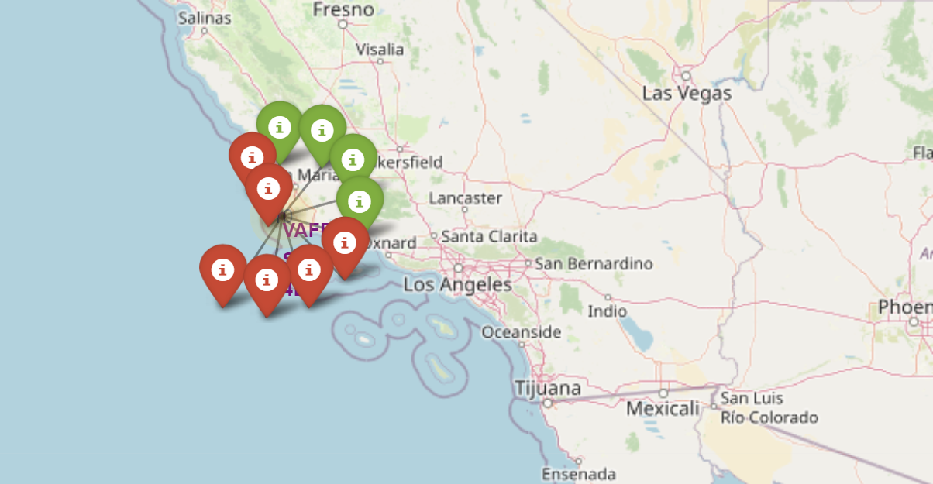
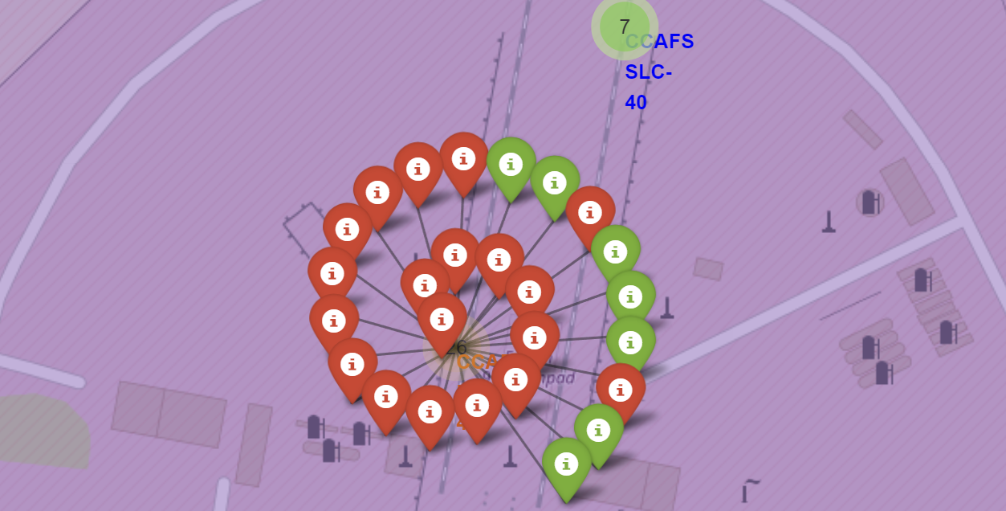

Slide 37
<Folium Map Screenshot 3>
Replace <Folium map screenshot 3> title with an appropriate title
Explore the generated folium map and show the screenshot of a selected launch site to its proximities such as railway, highway, coastline, with distance calculated and displayed
Explain the important elements and findings on the screenshot

Slide 38

Section 4

Slide 39
<Dashboard Screenshot 1>
Replace <Dashboard screenshot 1> title with an appropriate title
Show the screenshot of launch success count for all sites, in a piechart
Explain the important elements and findings on the screenshot

Slide 40
<Dashboard Screenshot 2>
Replace <Dashboard screenshot 2> title with an appropriate title
Show the screenshot of the piechart for the launch site with highest launch success ratio
Explain the important elements and findings on the screenshot

Slide 41
<Dashboard Screenshot 3>
Replace <Dashboard screenshot 3> title with an appropriate title
Show screenshots of Payload vs. Launch Outcome scatter plot for all sites, with different payload selected in the range slider
Explain the important elements and findings on the screenshot, such as which payload range or booster version have the largest success rate, etc.

Slide 42

Section 5

Slide 43
Classification Accuracy
Visualize the built model accuracy for all built classification models, in a bar chart
Find which model has the highest classification accuracy

Slide 44
Confusion Matrix
Show the confusion matrix of the best performing model with an explanation

Slide 45
Conclusions
Point 1
Point 2
Point 3
Point 4
…

Slide 46
Appendix
Include any relevant assets like Python code snippets, SQL queries, charts, Notebook outputs, or data sets that you may have created during this project

Slide 47


